Slide 1
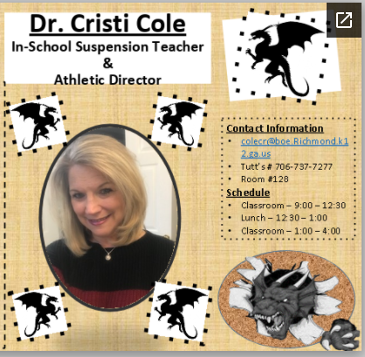
Welcome to Tutt Middle School!
I am proud to be a Tutt Dragon & for teaching at my alma mater 29th years. I have enjoyed years of teaching students & getting to know their families. I am blessed to have been given this opportunity. I still enjoy coming to school every day. My passion for all that encompasses the profession of education brings joy to my heart.

